Slide 1
Page 9
To understand the designs of the whole universe
you only have to know about the numbers
1 2 3 4 5 6 7 8 9 10 11 12
The numbers 1-12
naturally form four groups:
Starting Principles: 1, 2
Numbers of Structure: 3, 4, 6, 8, 12
Numbers of Life: 5, 10
Numbers of Mystery: 7, 9, 11
Michael S. Schneider
www.constructingtheuniverse.com

Slide 2
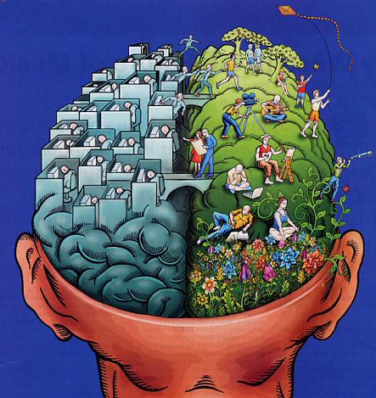
Pages 10-11
1 and 2,
symbols of
unity and polarity.

Slide 3
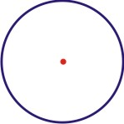
Page 12
1 - The Supreme Number
(although not considered a number but the source of numbers)
The One as the Circle with a Central Point
Qualities or Archetypal Principles
of the circle glyph:
Unity
Wholeness
Completeness
Equality
Perfection

Slide 4
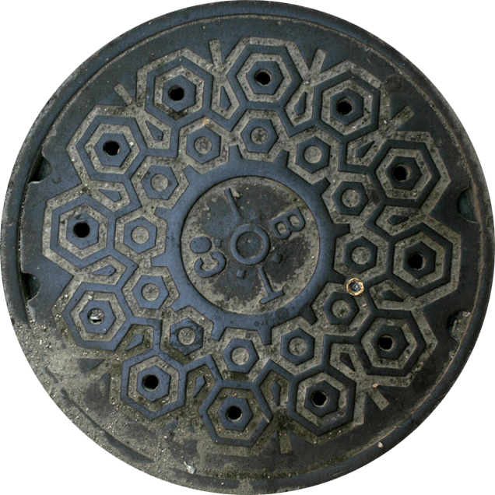
A circle is the only shape that can’t fall into it’s own hole!

Slide 5
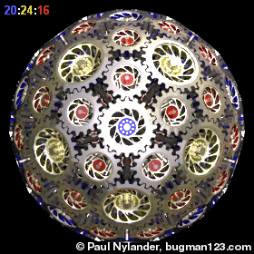

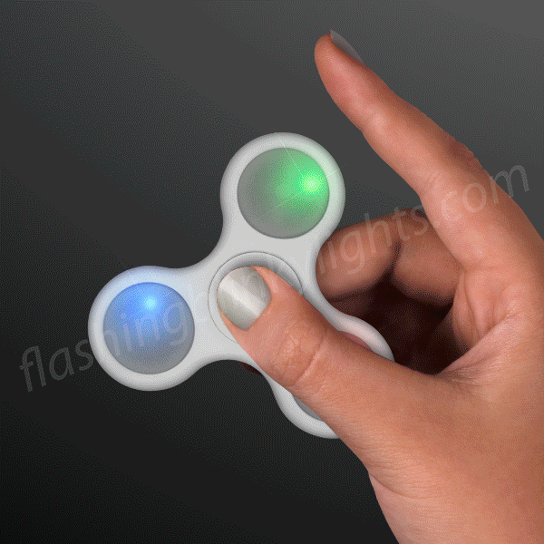
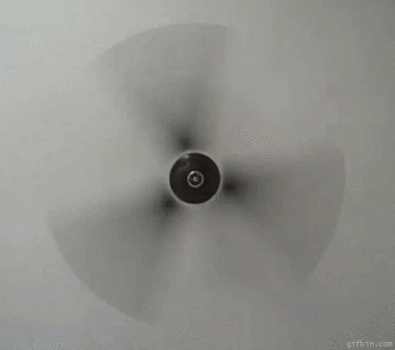
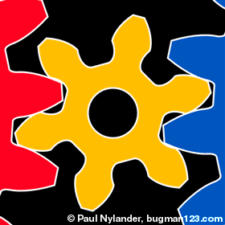
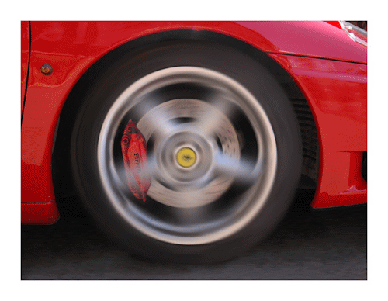
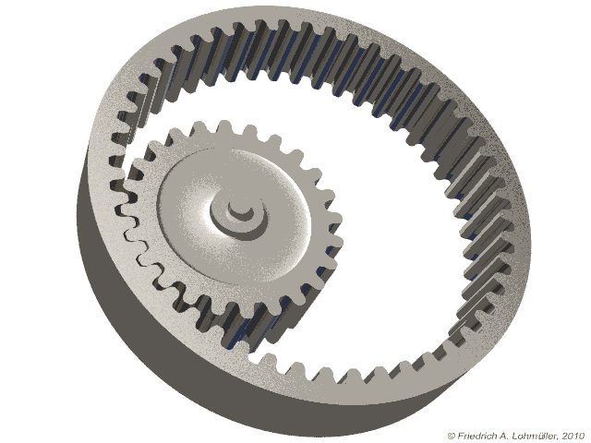
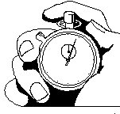

Circles as Spinning Cycles
Beyond 1550 cycles per second the separate blades appear to be a solid disc.

Slide 6
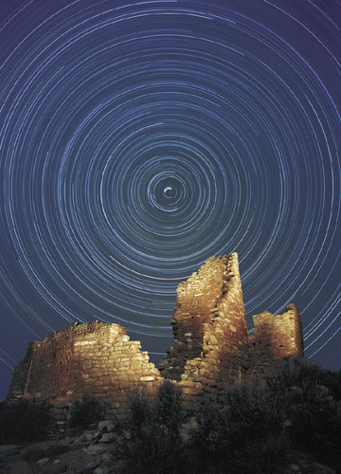
"Everything an Indian does is in a circle, and that is because the power of the world always works in circles, and everything tries to be round.“
-- Black Elk (1863-1950)

Slide 7
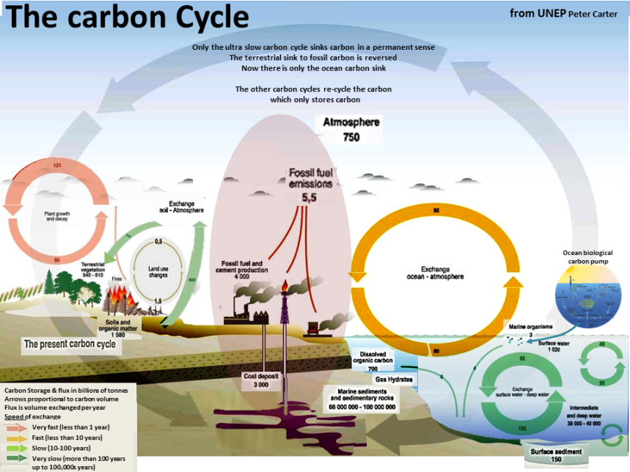
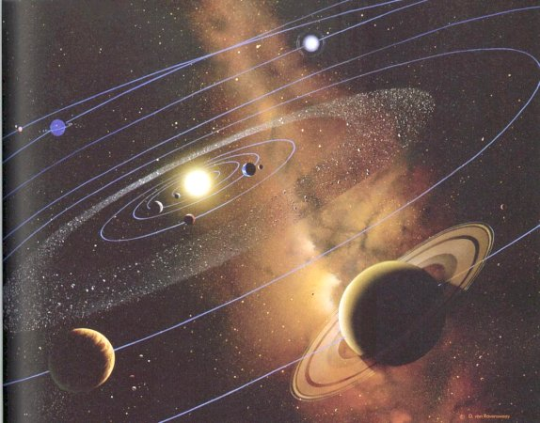
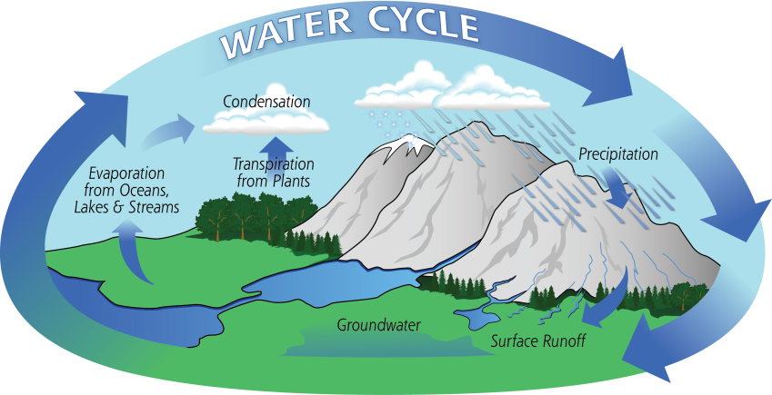
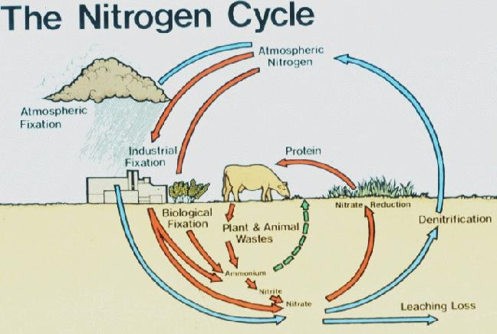
Nature writes with the circle glyph

Slide 8

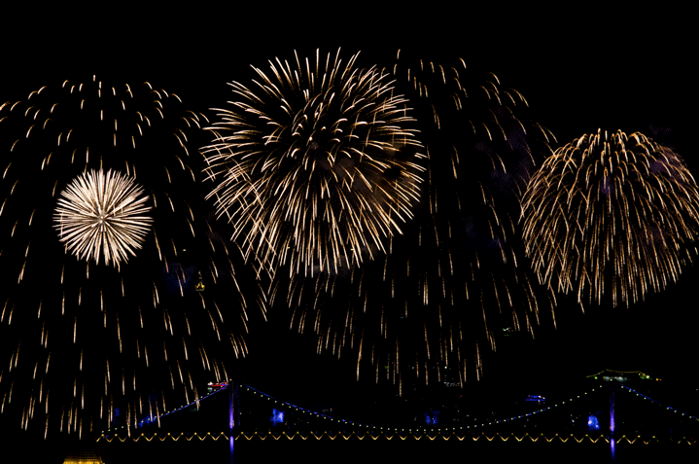
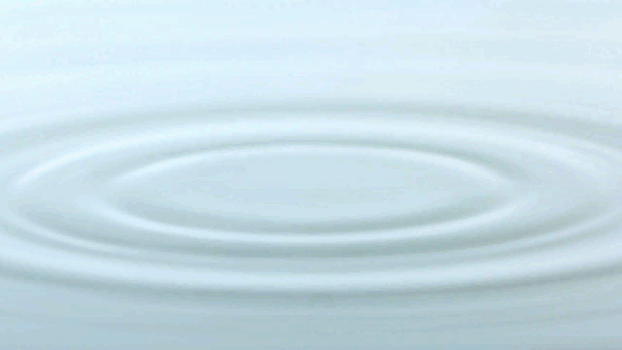
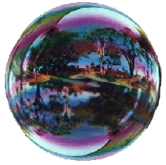
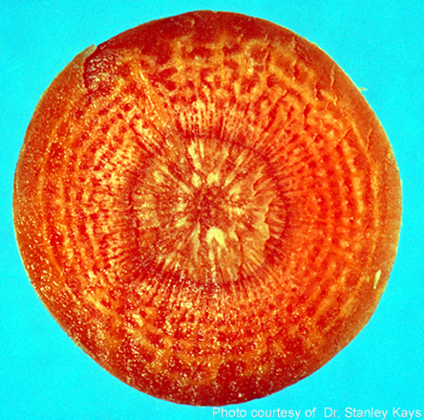
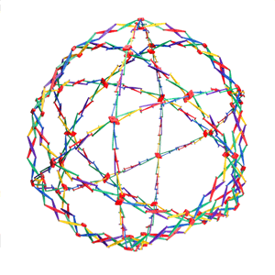
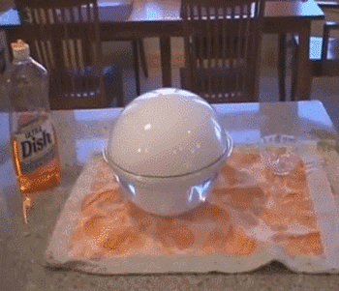
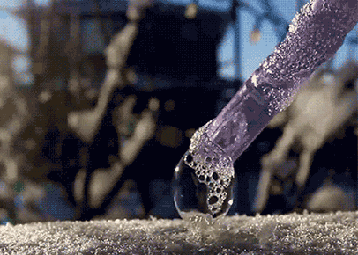
Equal Expansion
All points of a circle (and sphere) are the same distance from the center.
Freezing soap bubble
CO₂

Slide 9
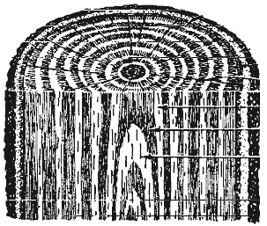
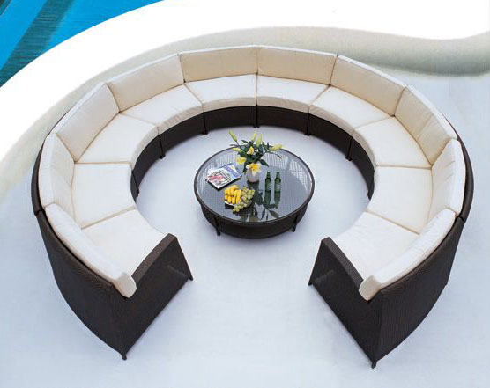
Expanding from a center ‘equally’ in all directions.
Equal access to the center

Slide 10
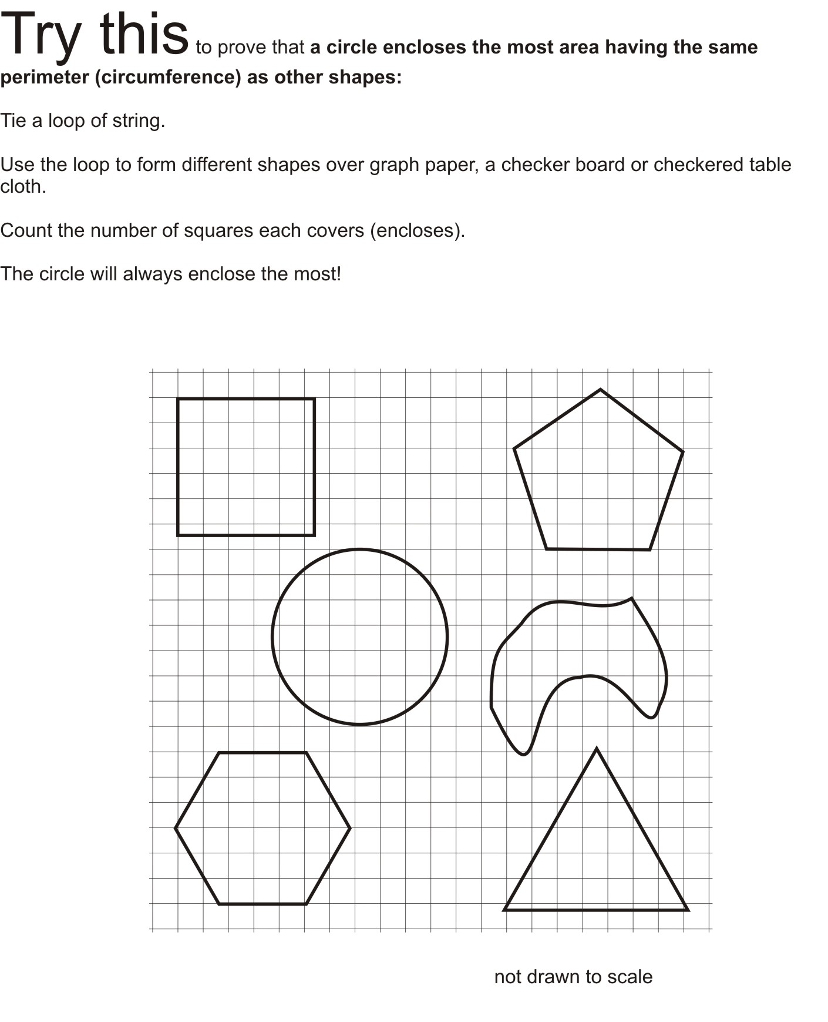
Page 14
Most
Least

Slide 11
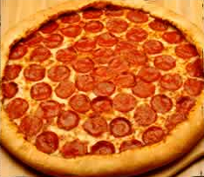
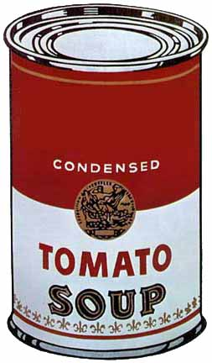
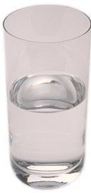
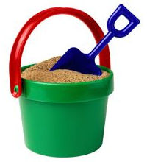
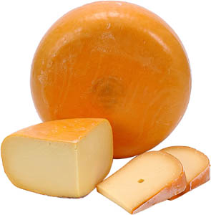
Circle: The shape with
The Most Inside with the Least Around
Page 13
Of all shapes with the same length of crust, round pizzas hold the most toppings.
So if you like toppings, get the round pizza
and not the square, rectangle or triangle
having the same perimeter.
Cylinders – Extruded Circles
They hold the most inside
using the same amount of material.
Using the same metal, any other shape of can (except sphere) would hold less soup
(or water, sand or cheese).

Slide 12
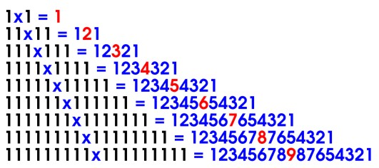
Unity, in the form of polarity, creates all the digits.
“Be fruitful and multiply!”

Slide 13
One by one
the single digits appear.

Slide 20
One through Nine appear
when One multiplies with Itself.

Slide 21
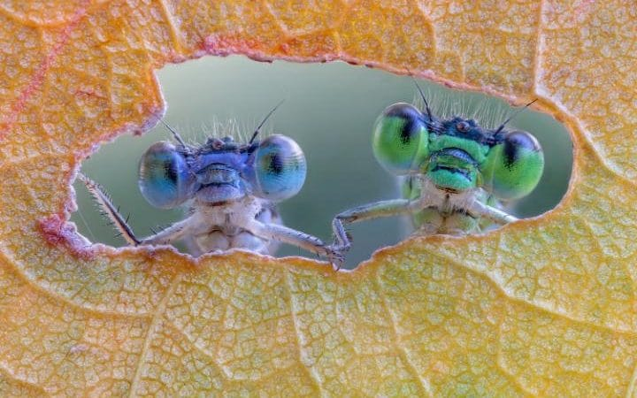
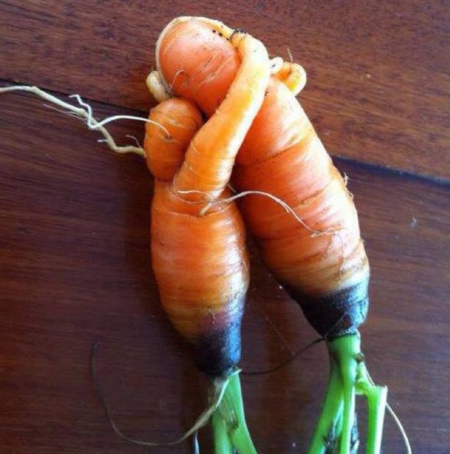
2

Slide 22
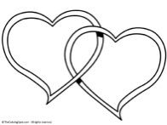
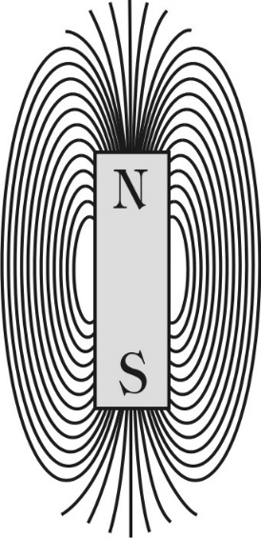

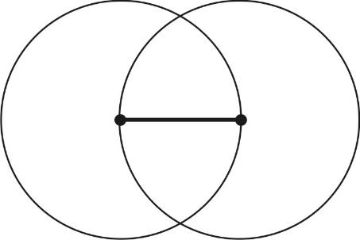
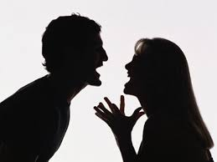
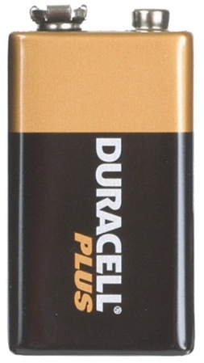
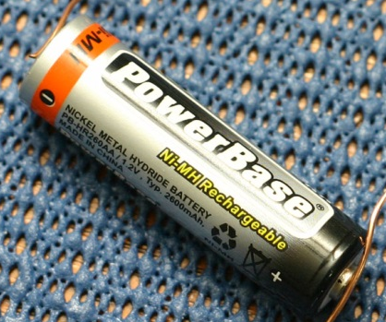

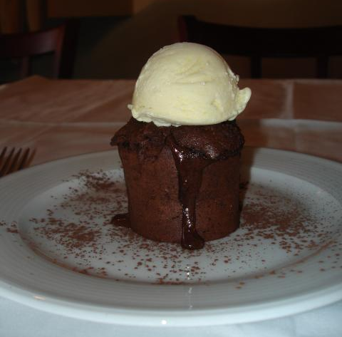
2 --Polarity: Contrast, Difference
Opposites in Conflict
Complements Cooperating
Page 15-16
Everything contains a bit of its own opposite

Slide 23
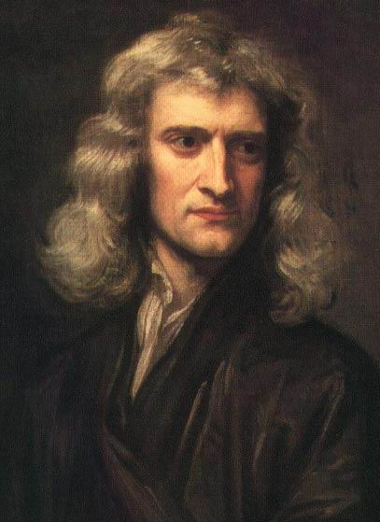
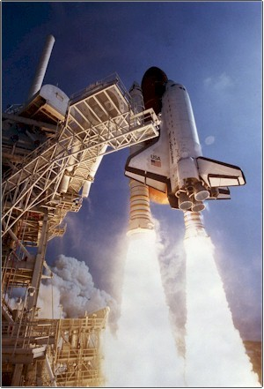
Sir Isaac Newton
Polarity as Opposition
“For ever action there is an
equal and opposite reaction.”
“For ever expert there is an
equal and opposite expert.”

Slide 24
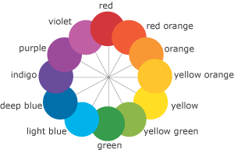
Page 18
Polarity: Complementary Colors
Complementary colors create the strongest
visual tension.

Slide 25
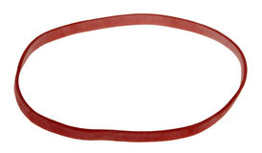
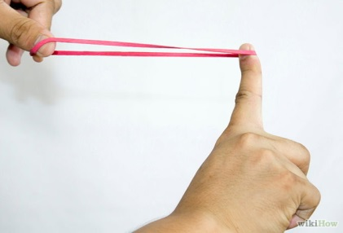
Unity
Polarity

Slide 26
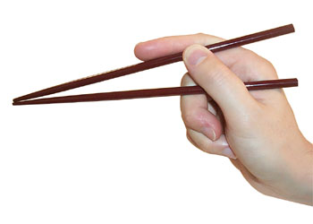
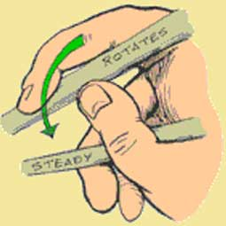
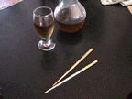
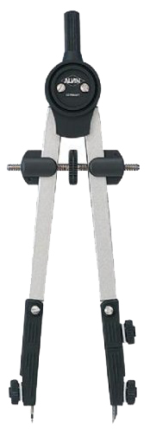

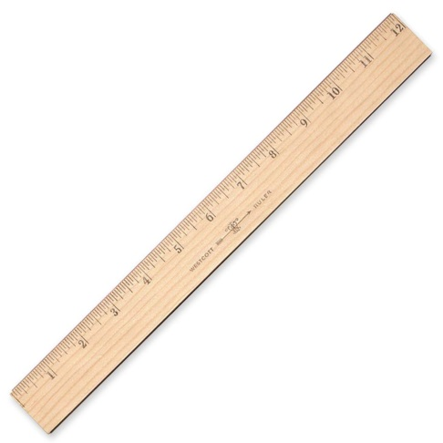
Chopsticks work by Polarity
One stick moves;
One stick remains steady.
Page 17
A Compass works by Polarity
One leg rotates on a single point;
The other leg moves, creating infinitely many points
Polarity:
Straight & Curved

Slide 27


Slide 28

My first selfie

Slide 29



You work for a month.
How would you prefer to be paid?
Start with 1 cent and double it every day for a month?
Day 1
Day 2
Day 3
Etc……
or
1 million dollars cash?
Add all these!

Slide 30



Slide 31

Page 19

Slide 32

32 16 8 4 2 1
32 16 8 4 2 1

Slide 33

Page 20
16 8 4 2 1
Blue = 0
Yellow = 1

Slide 34

Page 20
A rhythm of dancing 0’s and 1’s
16 8 4 2 1
8 4 2 1
A
B
C
D
E
F
G
H
I
J
K
L
M
N
O
…
Create a message seen as a pattern!
Blue = 0
Yellow = 1

Slide 35

Page 21
Color the boxes to see the pattern!
What’s the pattern made by your name?

Slide 36

What’s their message?
16 8 4 2 1

Slide 37


Slide 38

Page 23
Translate these Binary numbers into Base 10:

Slide 39

Page 24

Slide 40
Page 23
Translate these Binary numbers into Base 10:
10
Sliding the digits to the left and adding a 0 will double its value
20
40
51
38
119
85
198

Slide 41
Page 24
1 1 0 0
1 1 0 0 0 0
1 1 0 0 0 0 0
1 1 0 0 0 0 0 0
1 1 1 0 0 0 0 1
Even
Put a 0 at it’s right end.
Put 00 at the right end (double it twice)

Slide 42




Slide 43



The “Digital World” of 0’s and 1’s
1 Bit = 0 or 1
1 Nybble = 4 Bits
1 Byte = 2 Nybbles = 8 Bits
1 MegaByte = 1 million Bytes
Burning a Disk
No change = 0
Melted Pit = 1
1 Byte
0
1
1
1
1
0
1
0
1
0
1

Slide 44

Page 22

Slide 45
Page 22
These have a 1 in the 16’s column
These have a 1 in the 1’s column
Each of these numbers has a “1” in that 1-2-4-8-16 column

Slide 46


The
Tower of Hanoi
Puzzle

Slide 47

There are two kinds of people in the world:
Those who think there are two kinds of people, and those who don’t.

Slide 48

Vi Hart’s
Binary Hand Dance
http://www.youtube.com/watch?v=OCYZTg3jahU

Slide 49





Page 25
Multiplying is really weaving!
12 x 23 = ?

Slide 50



Page 26
Homework?
Design or create (in any media) an original exploration of “polarity.”
Create a message disguised as a design?
A series of photographs?
Experiments with color tensions?
Illustrations involving polarity?
Playing with polarity in textiles or fashion?
Film, animation or music?

Slide 52



The artist has communicated his message with just two simple contrasting lines

Slide 53



Most Inside – Least Around
Modern dinner plate
Cross-section of Horsetail plant
(around for 300 million years)

